Slide 1
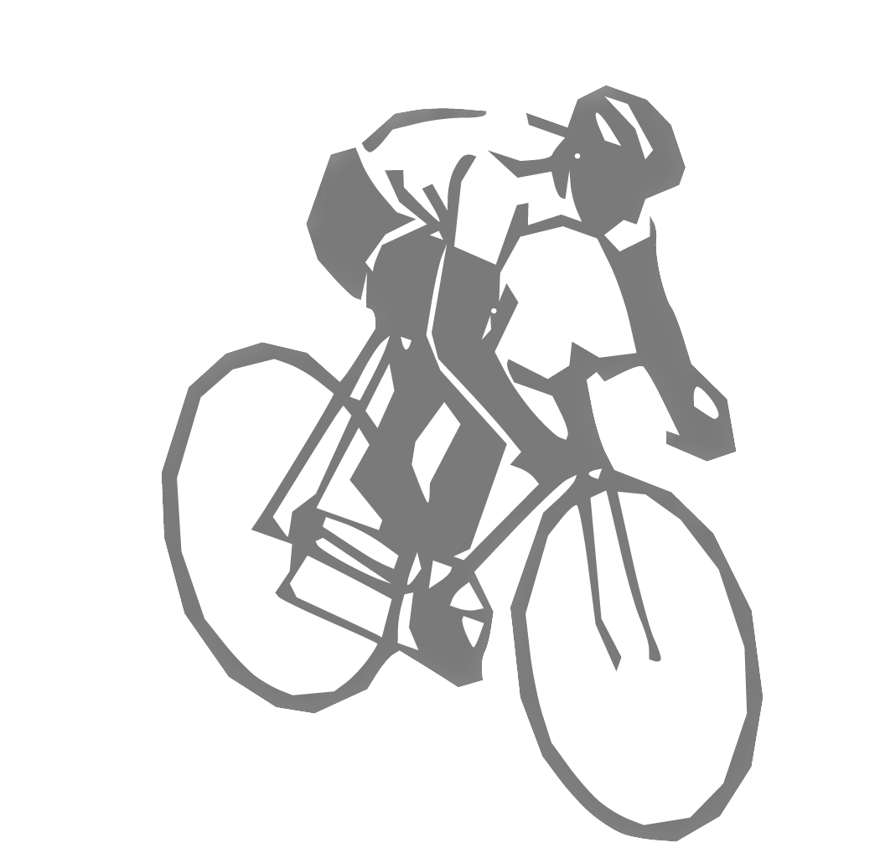
MUSCLE ACTIVATION PROJECT
Risheekesh Kesavan, Pratiksha Ganesan, Mikayla Schneider, Ravesh Sukhnandan

Slide 2
INTRODUCTION
APPLICATIONS OF MUSCLE MODELLING:
Modelling and Simulation of human biomechanics
Physical therapy/orthopedic surgery
Optimizing sports performance
Robotics
Each joint in the human body has a number of kinematic degrees of freedom, and each action can be performed in different ways using different combinations of muscles to achieve the same joint torque needed for this movement.
Experimental studies have found significant similarity in these muscle activation patterns for different individuals.
Modelled simulations can be applied to predict changes of kinematics and muscle response to interventions or environmental changes. They can support decisions in orthopaedic surgery.
PROBLEM STATEMENT:
We aim to optimize the lower limb muscle activations during cycling by using external applied forces and kinematics from literature.
[1] Which Muscles Are Used When Riding a Bike?, (Mar. 30, 2017). [Online Video]. Available: https://www.youtube.com/watch?v=MqLHuwxB5-c
Notes:
The human body has more muscles that it does degrees-of-freedom. An example of this is looking at the lower limbs. The knee for instance is a single degree of freedom joint, but yet there are many muscles spanning it. For example the quadriceps that extend the knee and the hamstrings that flex the knee. How does the body decide what muscle(s) to activate to perform a given task? This is an important question to answer because it has implications across a variety of different fields. By modelling and simulating human biomechanics, we can use this information to guide physical therapy and surgery for muscle dysfunction. We can also optimize sports performance. Finally, this may also have applications to robotics, where using these neuromuscular control strategies to control a highly redundant system remains very difficult.
Each joint in the human body has a number of kinematic degrees of freedom, and each action can be performed in different ways using different combinations of muscles to achieve the same joint torque needed for this movement.
Experimental studies have found significant similarity in these muscle activation patterns for different individuals.
Modelled simulations can be applied to predict changes of kinematics and muscle response to interventions or environmental changes. They can support decisions in orthopaedic surgery.

Slide 3
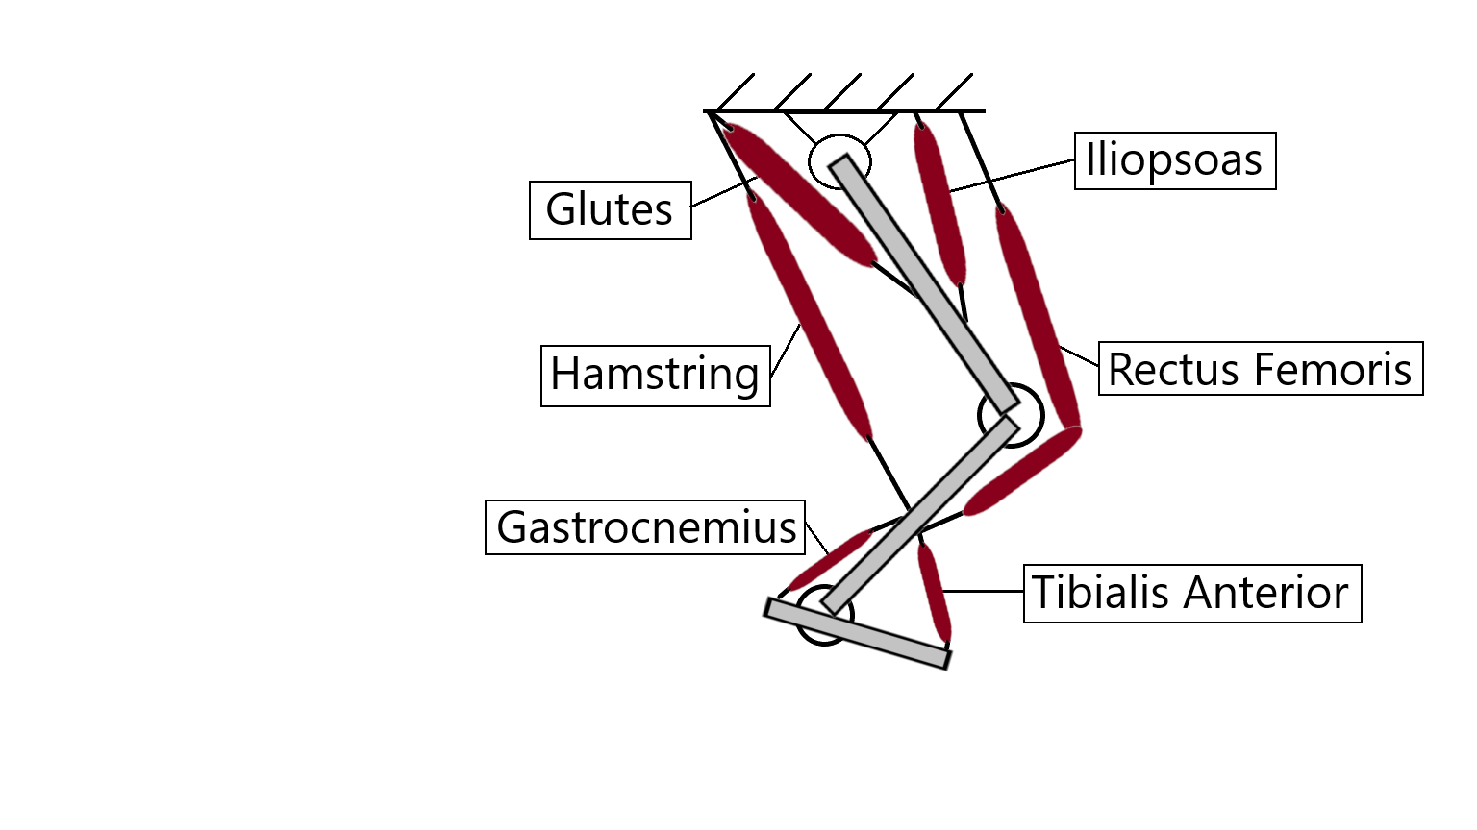
PROBLEM STATEMENT
Problem Statement:
We aim to optimize the lower limb muscle activations during cycling by using external applied forces and kinematics from literature.
Notes:
The particular application that we want to explore is that of cycling, which is amenable to analysis because the motion happens in a 2D plane and exhibits muscle redundancy. On the image on the left, you’ll notice that multiple muscles are being activated in red as the cyclists pedals the bicycle. Understanding which muscles are active when may be framed as an optimization problem. Our problem statement is that we aim to optimize the lower limb muscle activations during cycling by using joint kinematics and kinetics from literature, and compare to previously gathered EMG data.

Slide 4
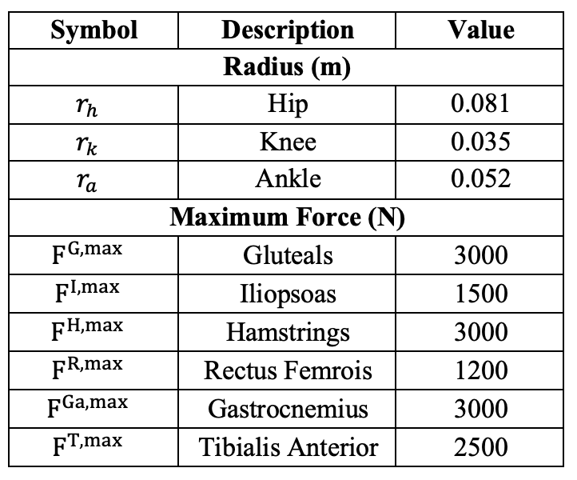
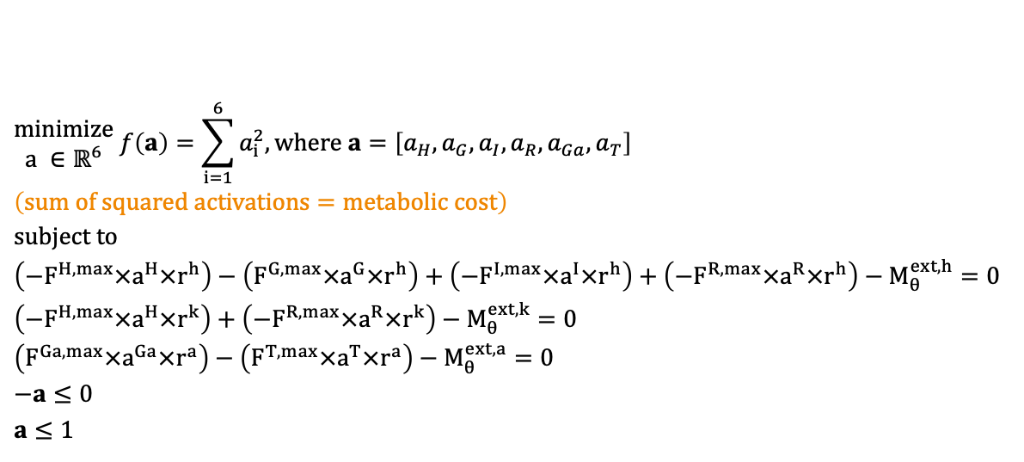
MODELLING
Minimize the metabolic cost of cycling, using the sum of squared activations as a proxy
Constrained by the moment required at each joint to produce the external force on the pedal
Table 1: Model Parameters
OBJECTIVE FUNCTION:
Notes:
defining your optimization problem statement with equations and words- Pratiksha/Mikayla

Slide 5
CLASSIFICATION OF OBJECTIVE FUNCTION
Problem | Convex objective, linear constraints, making it a convex problem
Solution | Global minimum
Algorithm choice | SQP (deals better with lot of constraints)
Algorithm comparison:
Algorithm | Time | Minimizer | Exitflag
SQP | 0.008 seconds | [0.18; 0.32; 0.1; 0.1; 0.63; 0.1] | 1
Interior point | 0.021 seconds | [0.18; 0.32; 0.1; 0.1; 0.63; 0.1] | 1
Notes:
As we have a lot of inequality constraints, we preferred sqp over interior point as fmincon sqp also uses active set strategy to focus on the important constraints

Slide 6







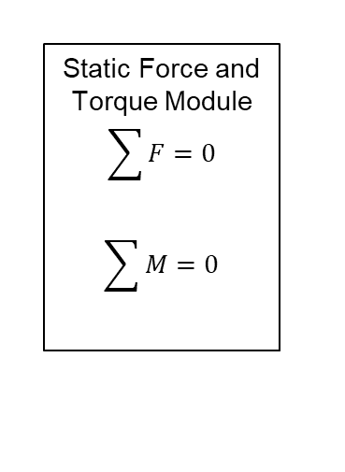
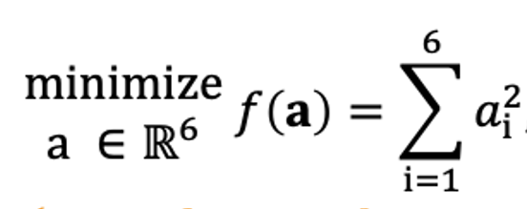
Data Flow for getting torques at knee joints
Pedal forces in the x- and y- direction
(Kautz et al.)
Optimization
Knee Torque
Hip Torque
Ankle Torque
Muscle Activations
[1] “CYCLING DATA,” International Society of Biomechanics. https://isbweb.org/resources/data-resources/140-movement-data/510-cycling-data
Notes:
Ravesh

Slide 7
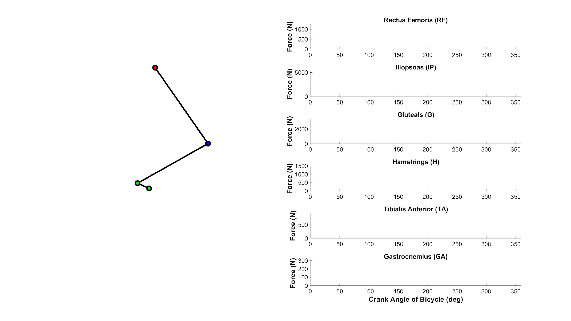
Solution to the muscle redundancy problem shows reasonable muscle forces
Notes:
Show force on slide 6. Slide 7 show activation

Slide 8
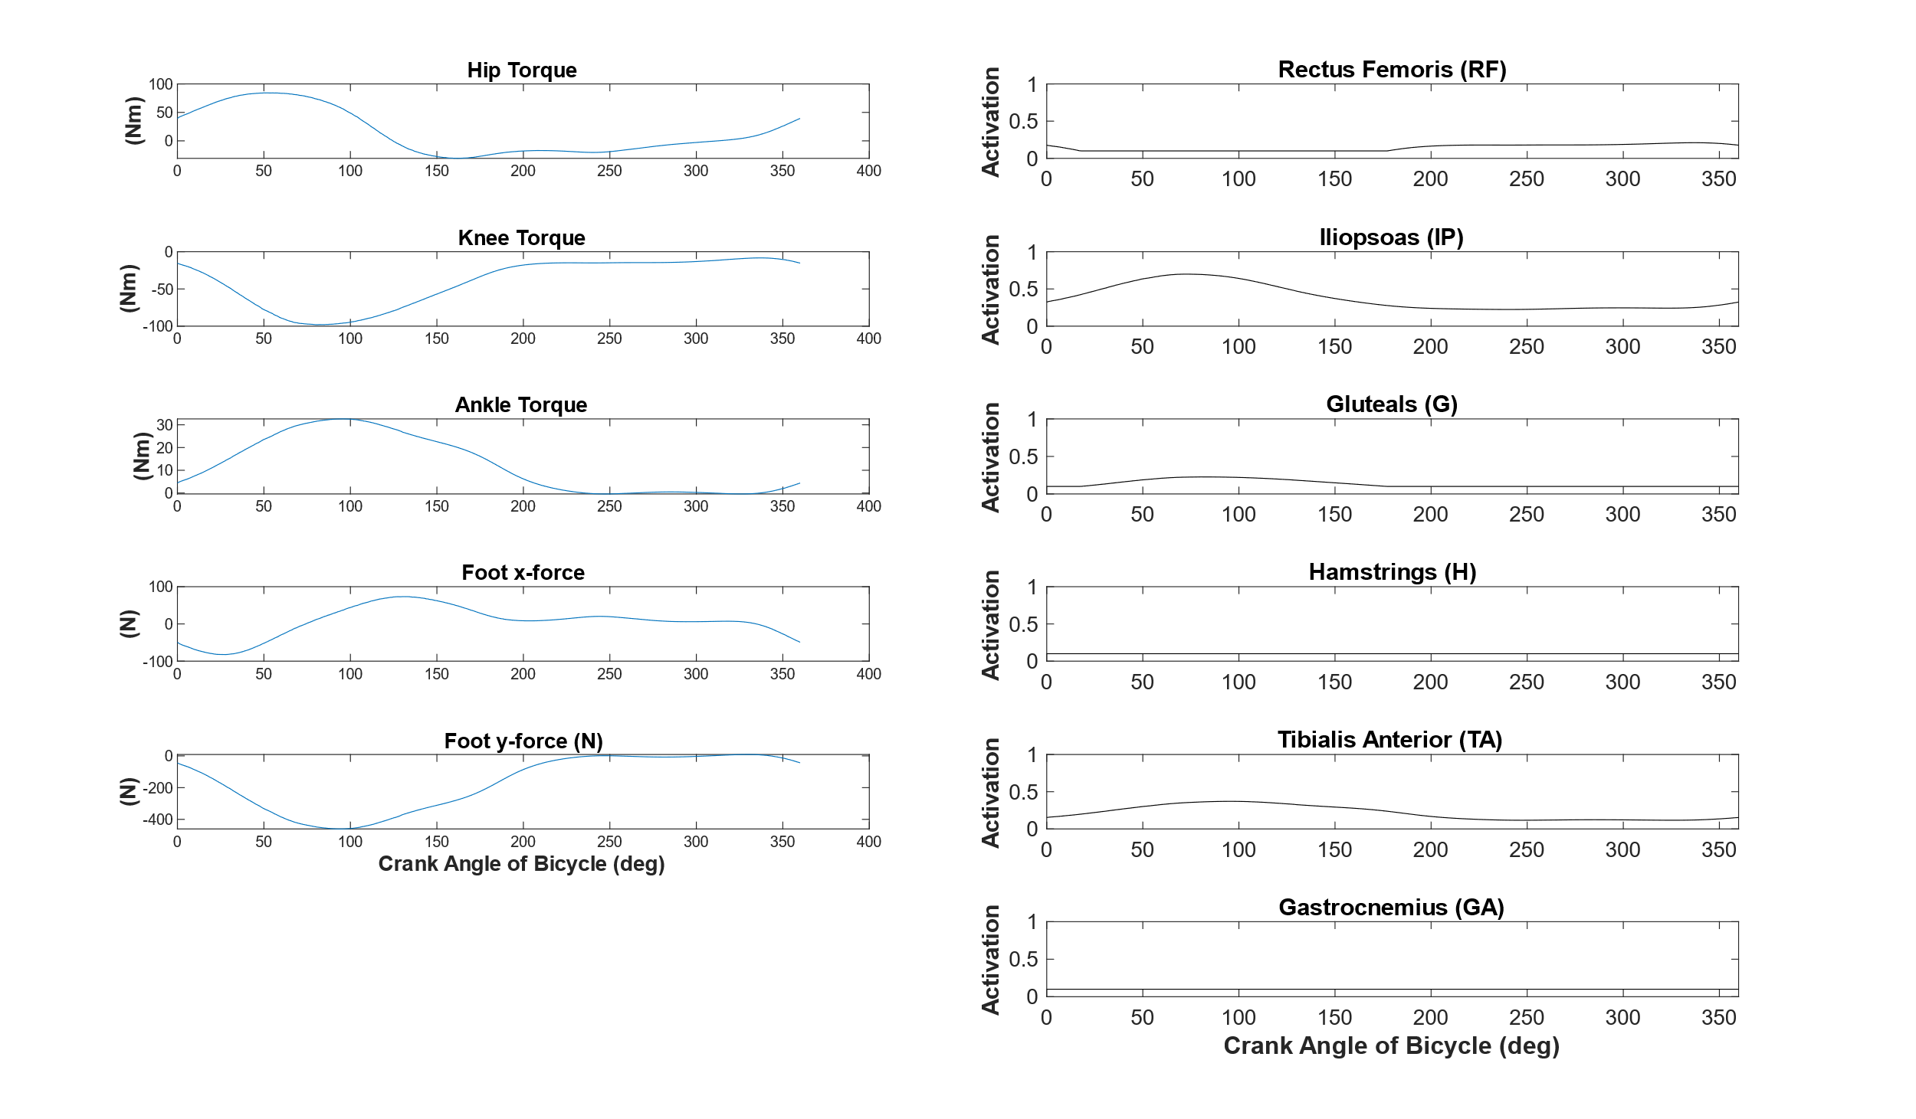
RESULTS
Notes:
Add picture of the leg (mirrored horizontally)

Slide 9
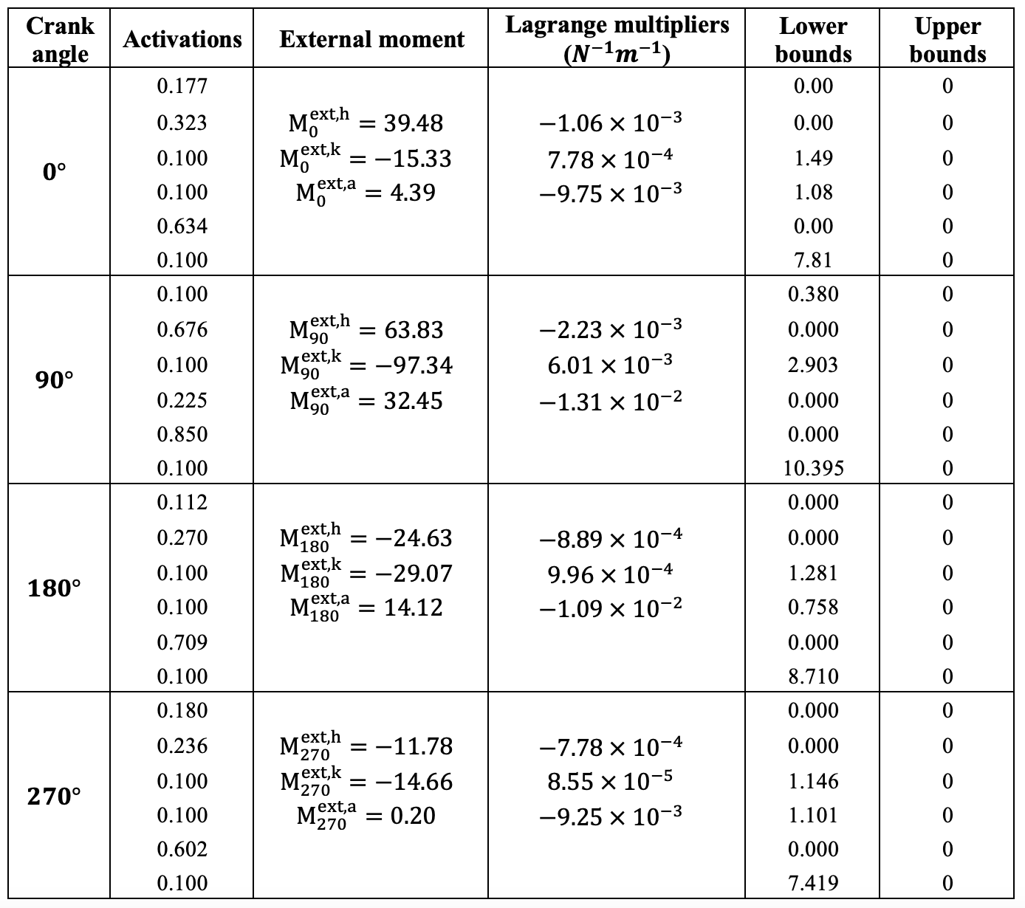
SOLUTIONS AND LAGRANGE MULTIPLIERS
Notes:
Include units of Lagrange multipliers

Slide 10
PARAMETER SENSITIVITY ANALYSIS: Θ = 90
Variable Changed | -30% Change |  |  |  |  |  | +30% Change
a | %Δ in RF | %Δ in IL | %Δ in GL | %Δ in HA | %Δ in TA | %Δ in GA | %Δ in RF | %Δ in IL | %Δ in GL | %Δ in HA | %Δ in TA | %Δ in GA
F^{max,RF} | 0 | 0 | 5.3 | 0 | 0 | 0 | 0 | 0 | -5.3 | 0 | 0 | 0
F^{max,IL} | 0 | -42.9 | 0 | 0 | 0 | 0 | 0 | 23.1 | 0 | 0 | 0 | 0
F^{max,GL} | 0 | 0 | -42.9 | 0 | 0 | 0 | 0 | 0 | 23.1 | 0 | 0 | 0
F^{max,HA} | 0 | 8.8 | 0 | 0 | 0 | 0 | 0 | -8.8 | 0 | 0 | 0 | 0
F^{max,TA} | 0 | 0 | 0 | 0 | -42.9 | 0 | 0 | 0 | 0 | 0 | 23.1 | 0
F^{max,GA} | 0 | 0 | 0 | 0 | 9.8 | 0 | 0 | 0 | 0 | 0 | -9.8 | 0

Slide 11
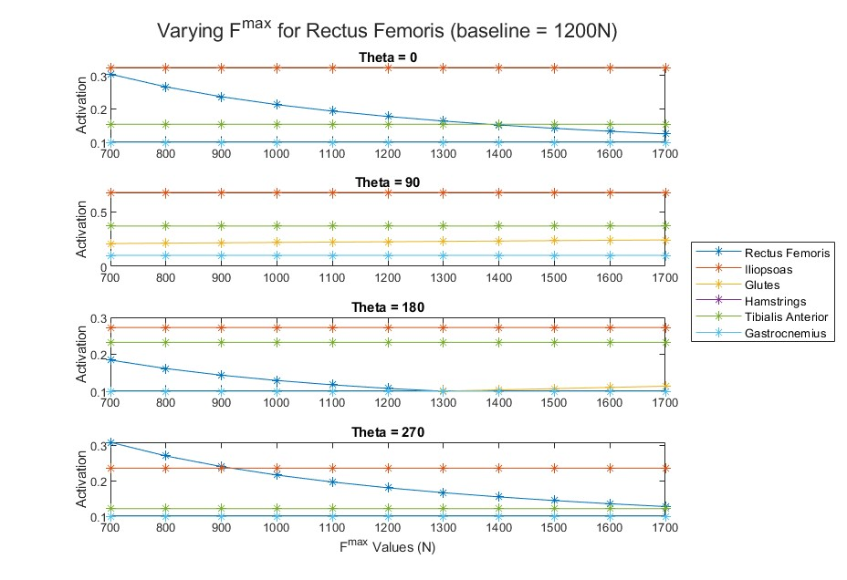
SENSITIVITY ANALYSIS: PARAMETER CHANGE EXAMPLE
Notes:
Report peak activation as function of percent change in max muscle force

Slide 12
LB SENSITIVITY ANALYSIS: -30% Change
f | λ | 0° | λ | 90° | λ | 180° | λ | 270°
LB^{RF} | 0 | 0 | + | 1.5 | 0 | 0 | 0 | 0
LB^{IL} | 0 | 0 | 0 | 0 | 0 | 0 | 0 | 0
LB^{GL} | + | 13.7 | + | 0 | + | 1.3 | + | 20.0
LB^{HA} | + | 21.3 | 0 | 12.2 | + | 20.1 | + | 22.4
LB^{TA} | 0 | 0 | 0 | 0 | 0 | 0 | 0 | 0
LB^{GA} | + | 7.8 | + | 4.5 | + | 12.1 | + | 6.0

Slide 13
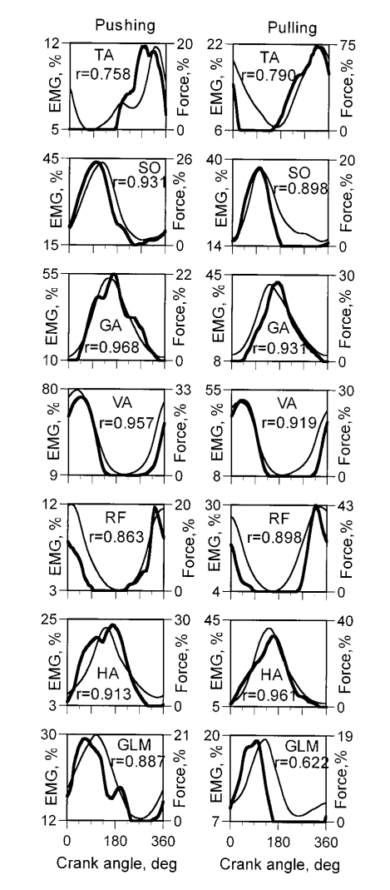
INTERPRETATION
Model Limitations
Number of Muscles, particularly biarticular
Joint Kinematics
Parameters
2D
Objective Function
FUTURE WORK
Nonlinear Force-Length-Velocity Relationship
3D
Notes:
- Mikayla

Slide 14
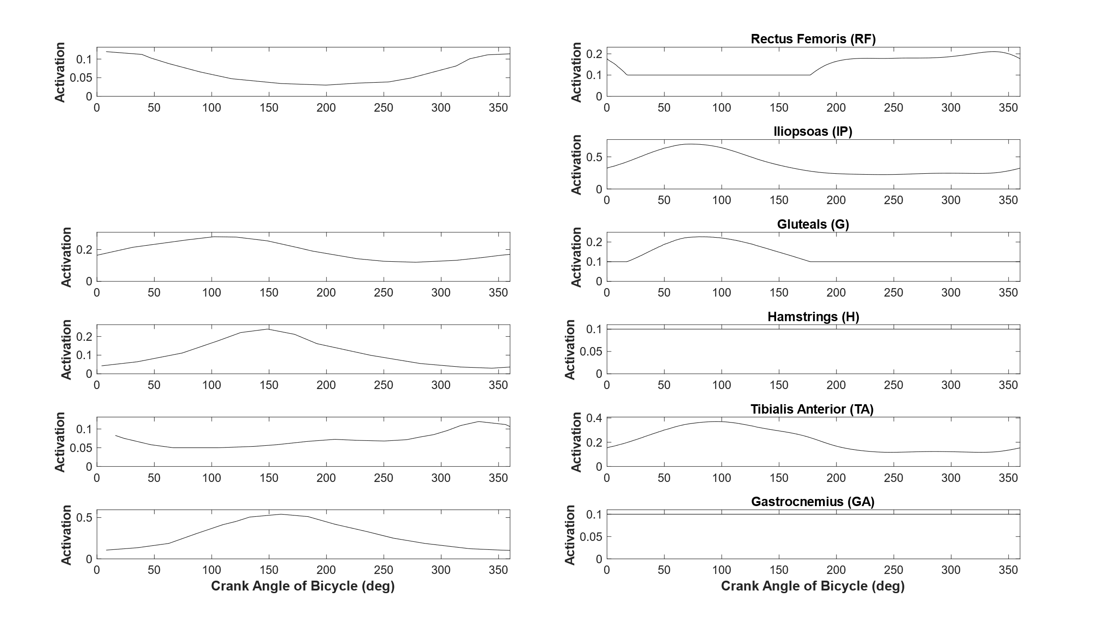
INTERPRETATION
Prilutsky et al. EMG Data
Our Activation Profiles
Notes:
- Mikayla

Slide 15
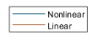
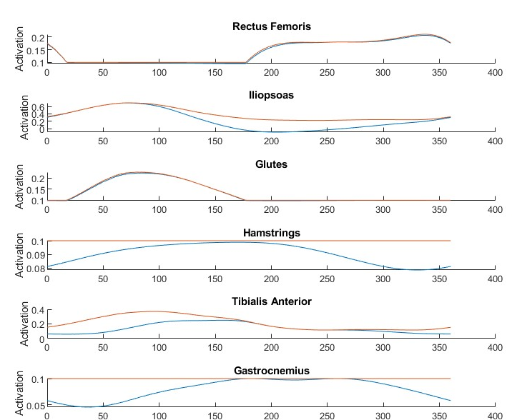
FORCE-LENGTH RELATIONSHIP
Prilutsky et al. EMG Data
Our Activation Profiles
Notes:
- Mikayla

Slide 16
CONCLUSIONS
FUTURE WORK
We were able to solve the muscle redundancy problem to get the muscle activations
While the activations were reasonable, they do not exactly match measured EMG profiles of cyclists.
A better match to the measured EMG could be done by increasing the realism of the model:
Implementing realistic muscle characteristics such as force-length, force-velocity and activation dynamics
Including the dynamics of motion instead of using a quasi-static assumption
Minimizing a different objective function such as one that promotes distribution of muscle forces in the leg muscles

Slide 17
Backup Slides

